Slide 1
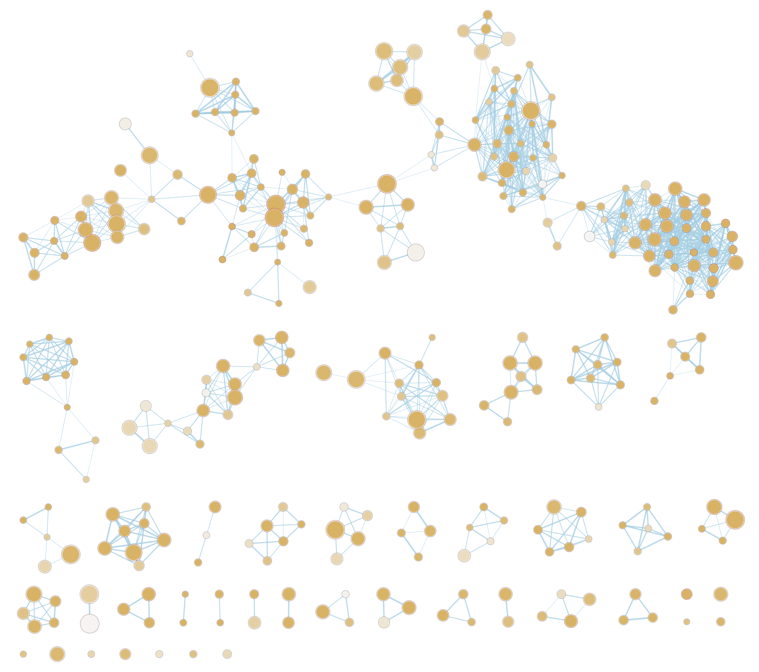
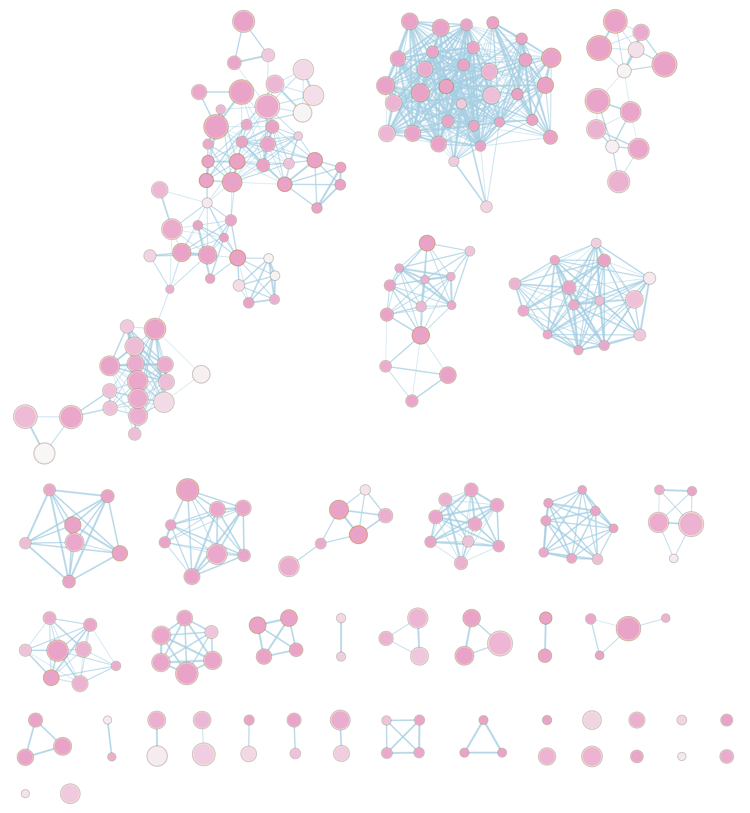
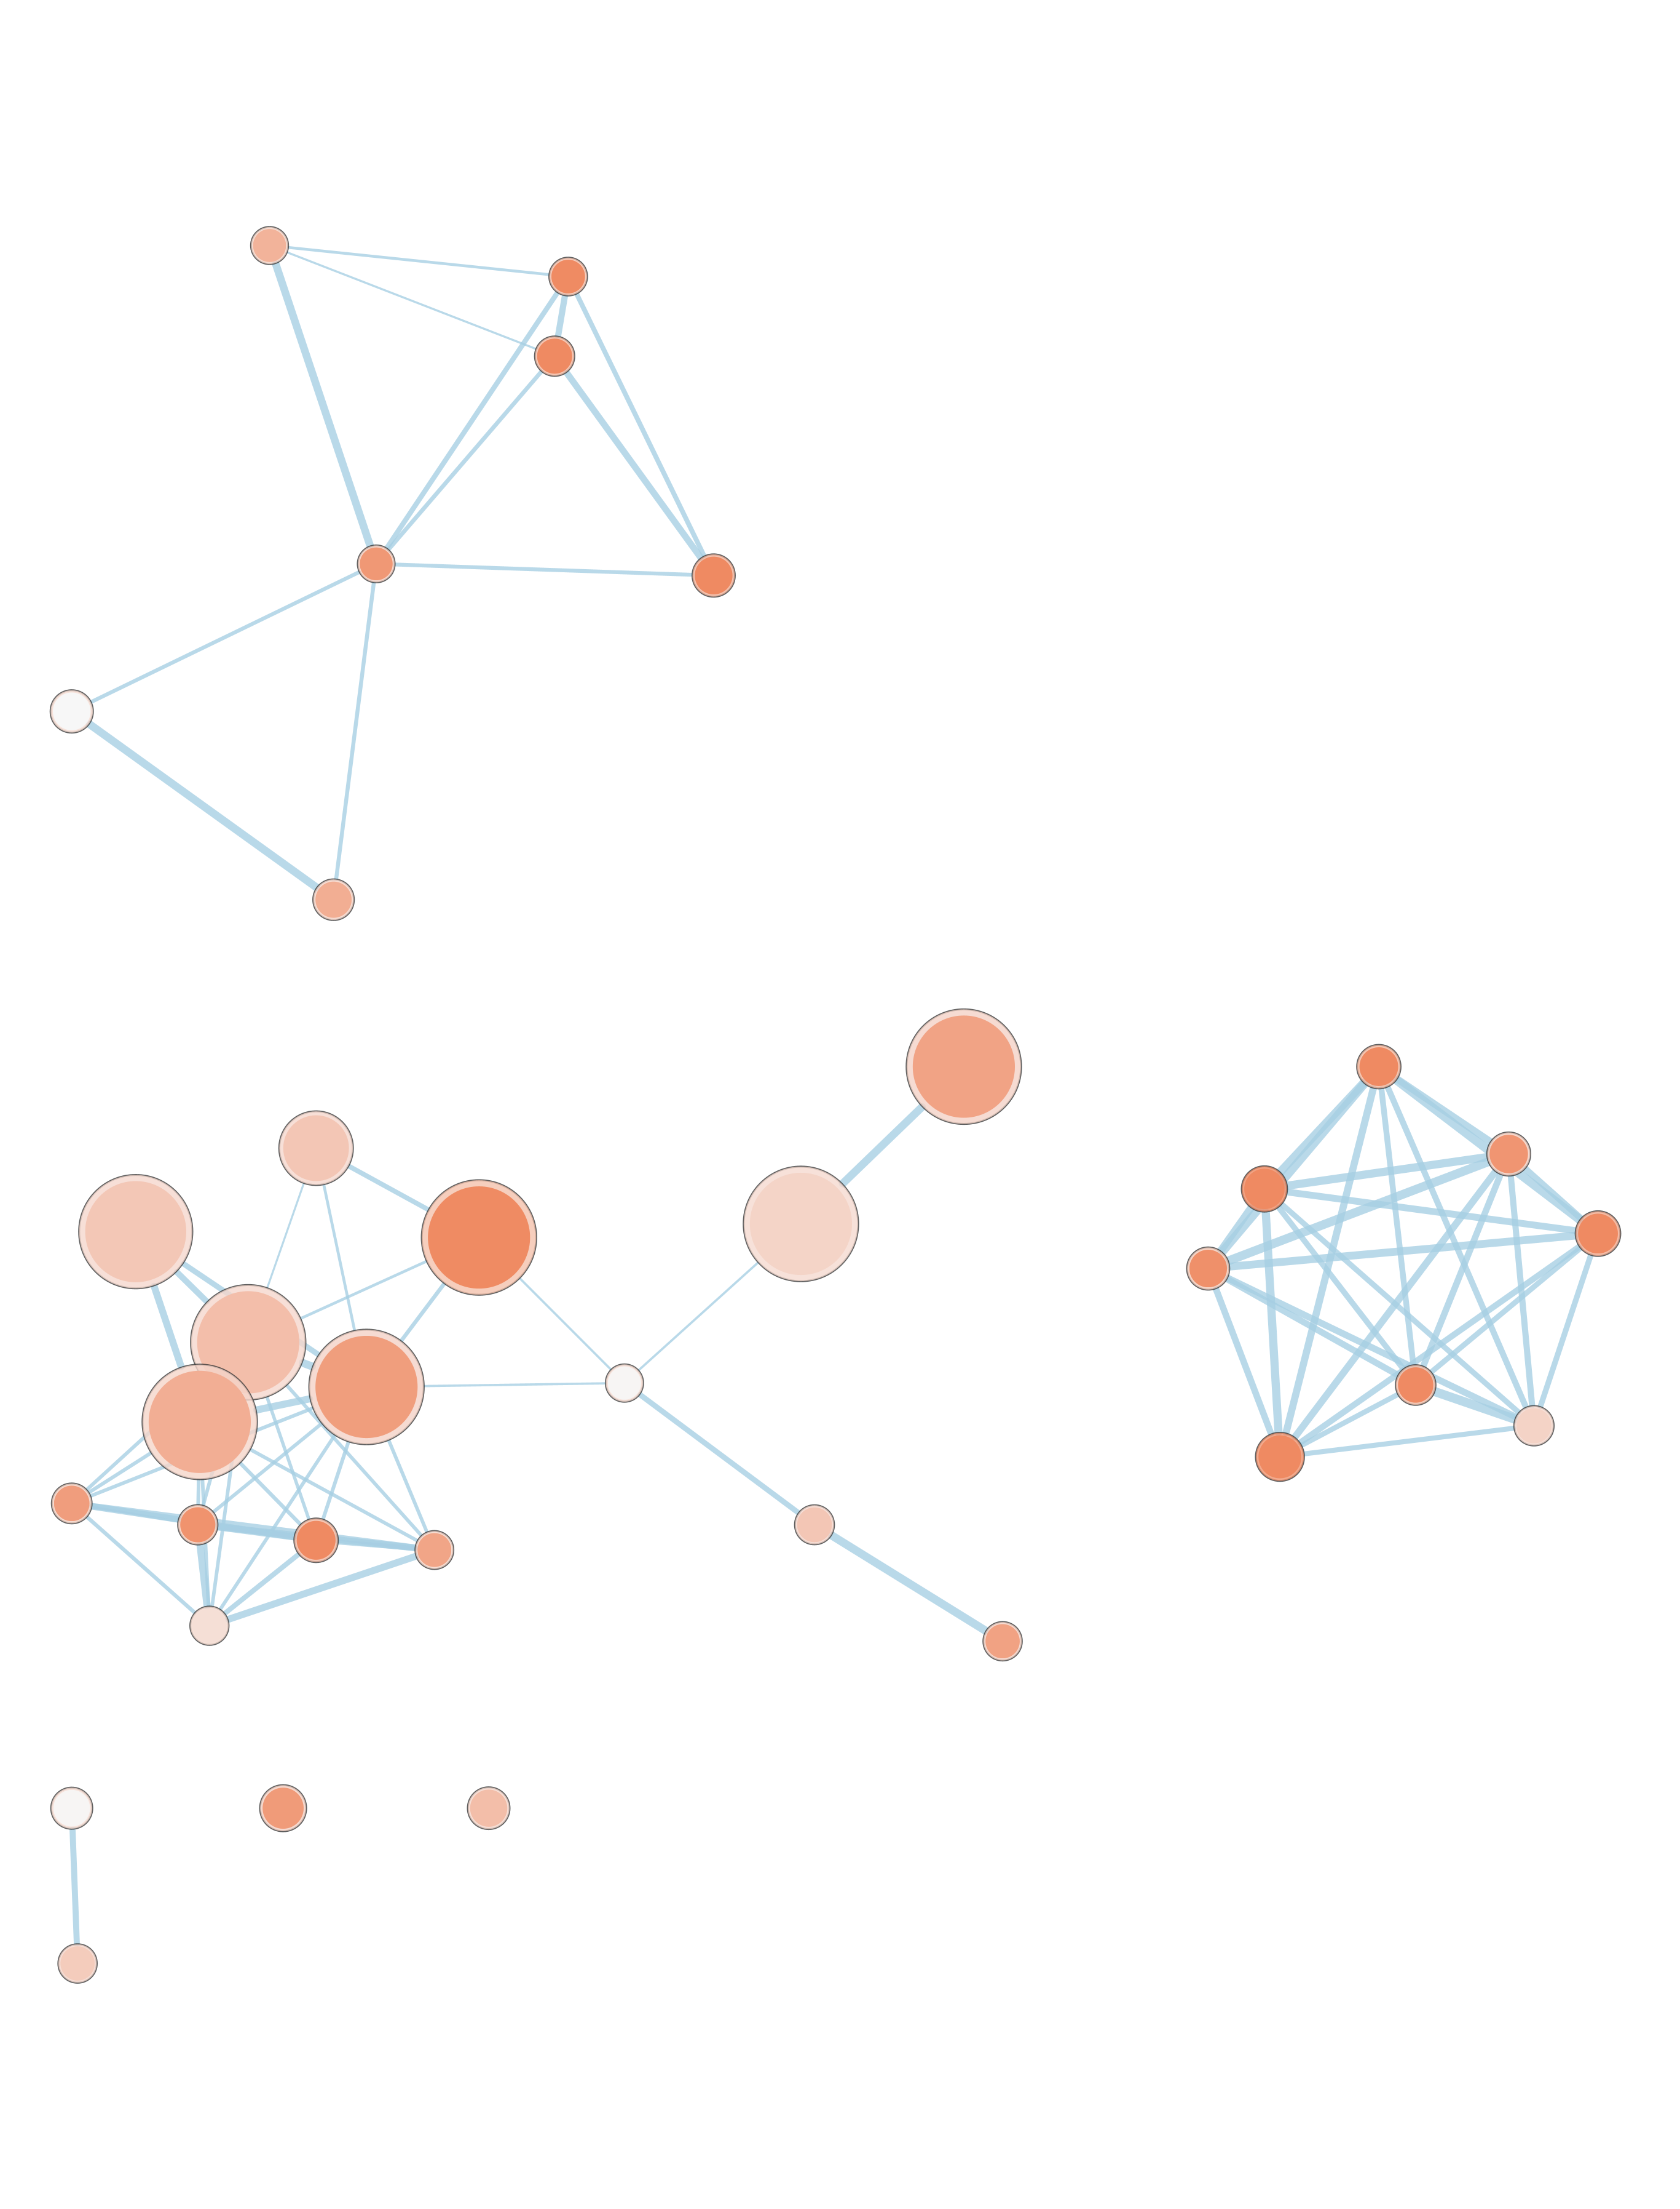
GVC
Agora
Open Targets
aerobic respiration
foam cell formation
cholesterol efflux
lipid transport
neurite development
efferocytosis
cholesterol efflux
Aβ clearance
synaptic transmission
synaptic transmission
aerobic respiration
immune response leukocyte adhesion
endocytosis
lipid transport
amyloid fibril formation
APP processing
neurite development
nuclear transport
immune response
kinase activity
GABAergic transmission
endopeptidase activity
immune response
response to Aβ
APP processing
miRNA transcription
wound healing
APP processing
cell migration
immune response
cell cycle
response to Aβ
lipid transport
leucocyte migration
response to ROS
endocytosis
Notes:
Run Agora genetics and omics separate
Run another neurod disease and a non-neurod disease

Slide 2
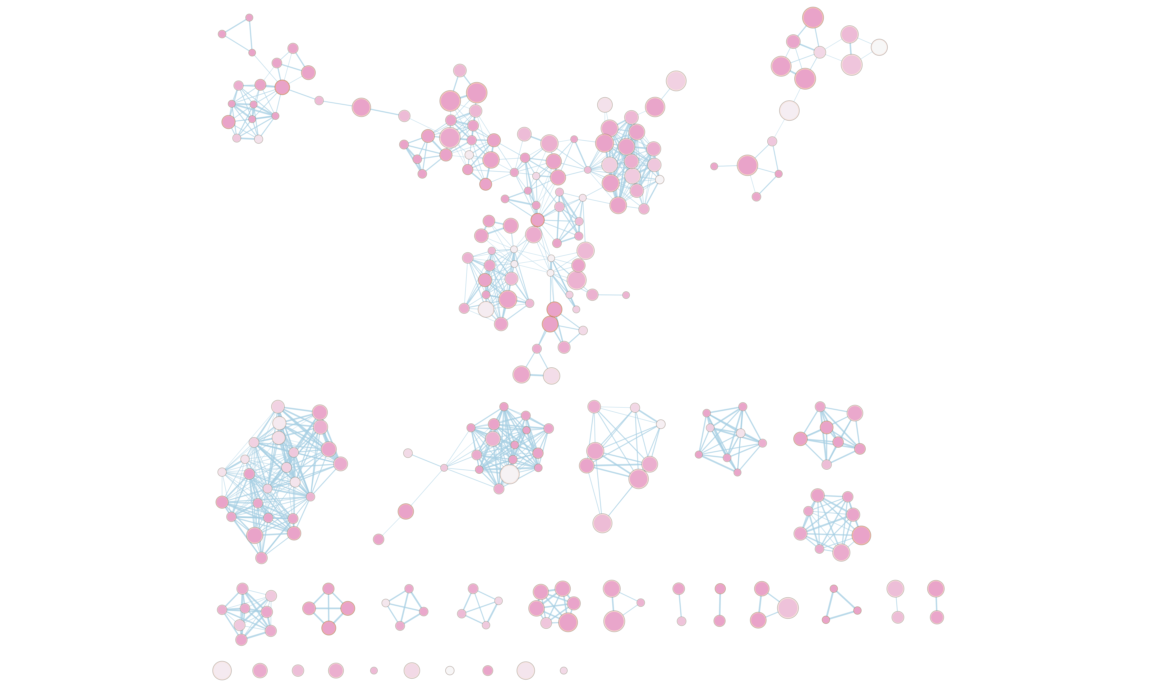
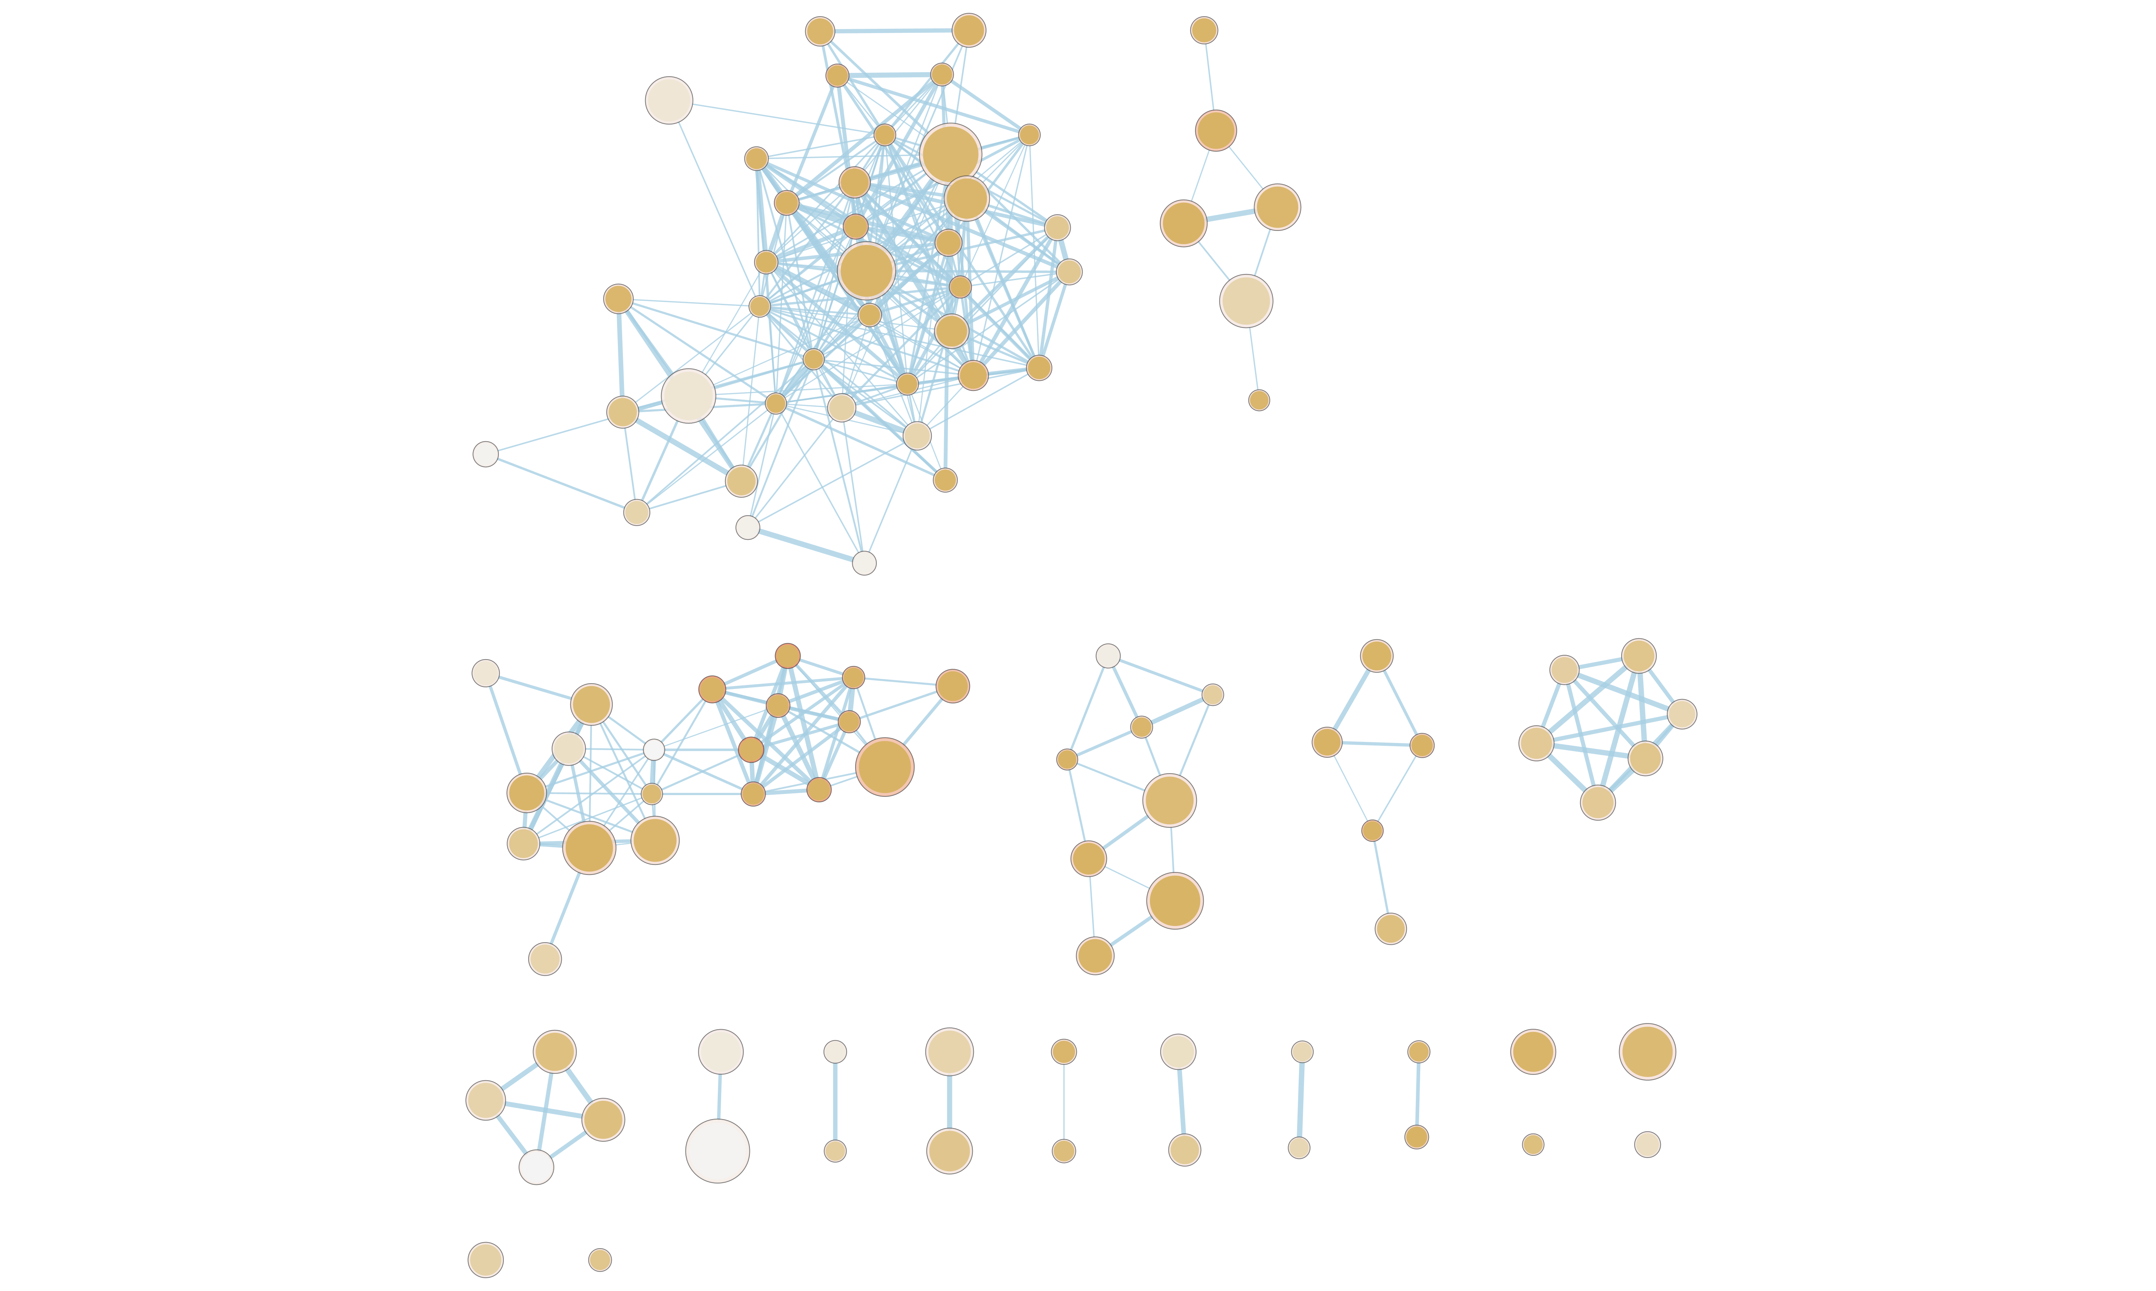
synaptic transmission
aerobic respiration
neurite development
nuclear transport
kinase activity
miRNA transcription
cell migration
cell cycle
response to Aβ
GABAergic transmission
response to ROS
endocytosis
GVC
Agora (genetics)
Open Targets (genetics)
Aβ clearance
neurite development
synaptic transmission
endocytosis
foam cell formation
cholesterol efflux
lipid transport
efferocytosis
cholesterol efflux
Aβ clearance
immune response
synaptic pruning
immune response leukocyte adhesion/proliferation
amyloid fibril formation
leukocyte migration
TNF production
amyloid fibril formation
immune response
APP processing
cholesterol efflux
APP processing
APP processing
Aβ clearance
lipid transport
endopeptidase activity
lipid transport
wound healing
aerobic respiration
response to Aβ
TNF production
amyloid fibril formation
Notes:
Run Agora genetics and omics separate
Run another neurod disease and a non-neurod disease

Slide 3
genetics
multiomics
target

Slide 4
AD
PD
MI

